Slide 1


Innovation Flows Here.
Notes:
Good morning, everyone!

Slide 2
University Database System: Design and Implementation
Andre de Breyne
Andre Ricardo Caralli Junior
Bruno de Arantes Leite Sassi
Isaac Inalegwu Agba
2025/03/25
Notes:
We are Group 1, consisting of Andre de Breyne, Andre Ricardo Caralli Junior, Bruno de Arantes Leite Sassi, and Isaac Inalegwu Agba.
Today, we’re presenting our project for the CPSC 500: SQL Databases course, taught by Dr. Sundus Shanef.
Our project is a university database system designed to manage academic operations and support machine learning applications.
We’ll also showcase additional SQL analyses to demonstrate our skills. Let’s get started.

Slide 3
Project Objective
Develop a database to manage university academic operations.
Support student enrollments, grades, courses, semesters, and prerequisites.
Generate datasets for machine learning (e.g., predicting student performance)
Notes:
Our project objective was to create a robust database to manage a university’s academic operations, such as student enrollments, grades, courses, semesters, and prerequisites. We also aimed to generate datasets for machine learning applications, like predicting student performance, which we’ll explore later. Additionally, we included extra SQL analyses to provide business insights, showcasing our broader proficiency in SQL and data analytics, as outlined in this slide.

Slide 4
System Overview
10 interrelated tables.
Key entities: Students, Instructors, Courses, Departments, Semesters.
Features: Enrollments, grading, prerequisites, course scheduling.
Notes:
Our university database system consists of 10 interrelated tables, including Students, Instructors, Courses, Departments, and Semesters, as shown here. It supports key features like student enrollments, grade recording, course prerequisites, and scheduling across semesters. The design is scalable and efficient, enabling both transactional operations, like recording grades, and analytical queries, which we’ll demonstrate later in the presentation.

Slide 5
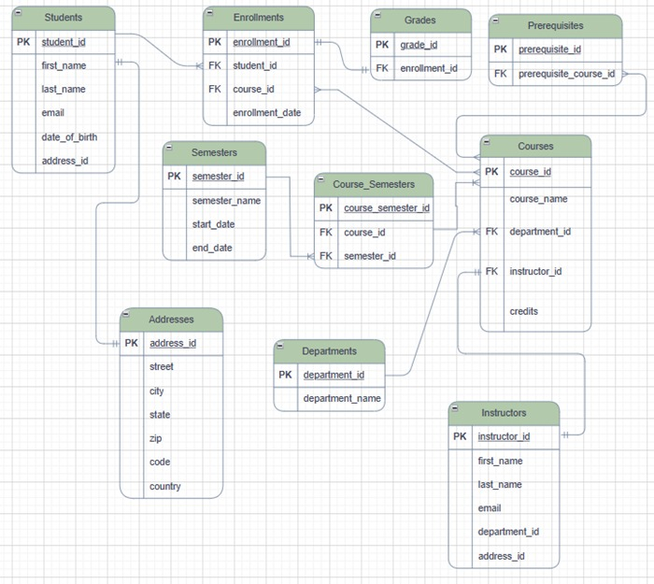
ER Diagram
Notes:
This is our ER Diagram, illustrating the relationships between the 10 tables in our system. For example, the Students table connects to Enrollments via student_id, which then links to Courses through course_id, tracking student enrollments. Junction tables like Course_Semesters map courses to semesters, and Prerequisites defines course dependencies. This design ensures data integrity and supports the features we outlined in the system overview.

Slide 6
Database Design: Relationships and Normalization
• Relationships:
Students 1:N Enrollments.
Courses N:N Semesters (via Course_Semesters).
• Normalization:
Up to 3NF (e.g., Addresses separated to avoid redundancy).
Notes:
Our database design defines clear relationships, as shown here. For instance, one student can have multiple enrollments, a 1:N relationship between Students and Enrollments. The Courses and Semesters relationship is N:N, implemented through the Course_Semesters junction table. We normalized the database to the third normal form, or 3NF, to eliminate redundancy—for example, by separating the Addresses table to avoid duplicating address data.

Slide 7
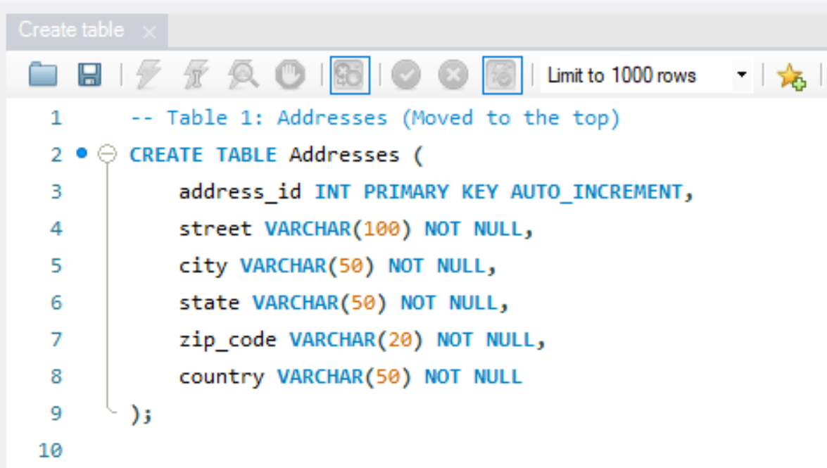
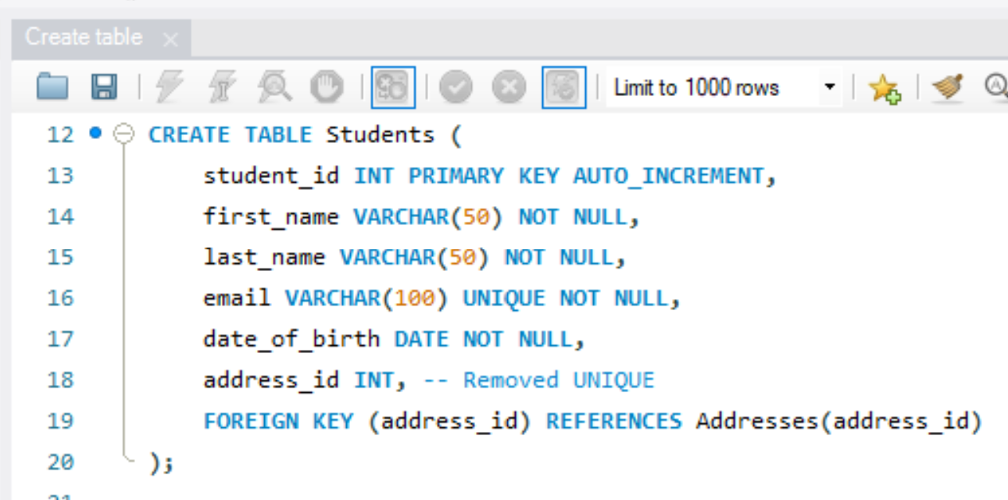
DDL: Database Creation
Used CREATE TABLE to define tables.
Constraints:
PRIMARY KEY, FOREIGN KEY, NOT NULL, UNIQUE.
Notes:
We used DDL commands to create our database tables, as shown here. For example, in the Students table, we set student_id as the primary key with AUTO_INCREMENT, made first_name and email mandatory with NOT NULL, and ensured email is unique with UNIQUE. Foreign keys, like address_id, link Students to Addresses, ensuring referential integrity across the system, aligning with our ER Diagram.

Slide 8
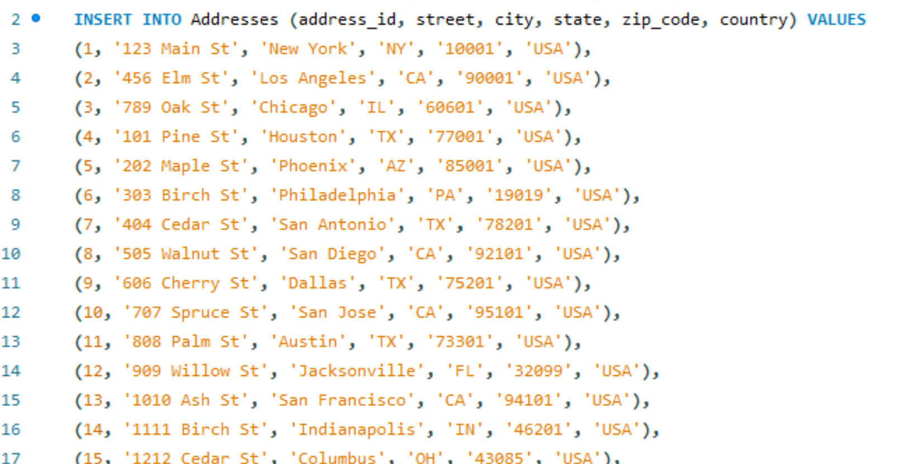
DML: Data Population
Data inserted:
70 students, 20 instructors, 50 courses, 10 departments, 10 semesters.
70 enrollments, 70 grades, 28 prerequisites.
Example:
Notes:
We populated our database using DML commands, inserting 70 students, 20 instructors, 50 courses, 10 departments, and 10 semesters, along with 100 enrollments, 100 grades, and 28 prerequisites, as shown here. For example, this INSERT command adds a student named John Doe with an email, date of birth, and address. We also tested UPDATE and DELETE operations to ensure the database can handle dynamic changes effectively.

Slide 9
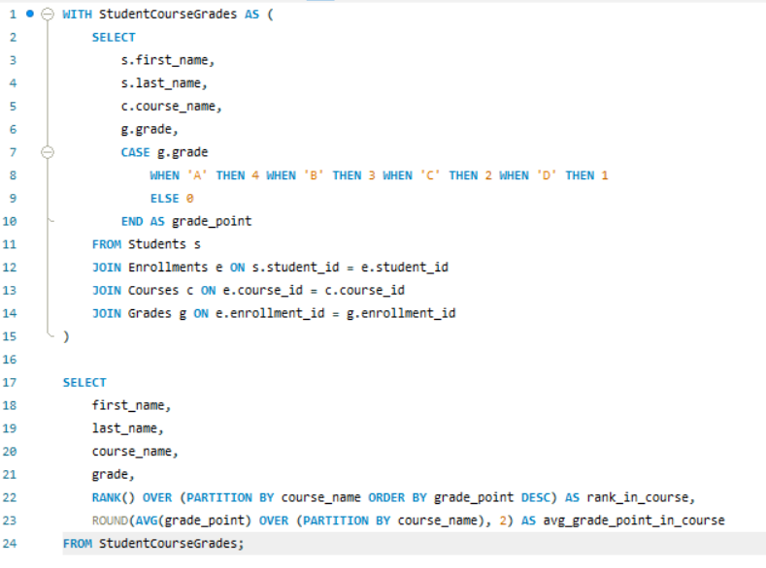
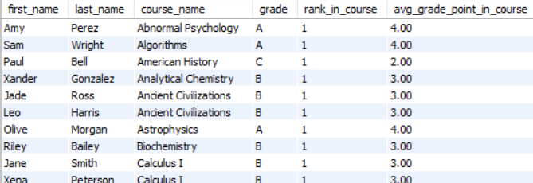
DQL: Reports and Analysis (Part 1 - University System)
Report 1: Student Performance by Course (with Ranking)
Output:
Notes:
Now, let’s explore our first DQL report, which analyzes student performance by course. We used a CTE to calculate grade points—assigning 4 for an A, 3 for a B, and so on—and ranked students within each course using the RANK() function, as shown. For example, John Doe earned an A in Intro to Programming, while Jane Smith got a B in Calculus I. This report helps identify top performers and supports academic decision-making.

Slide 10
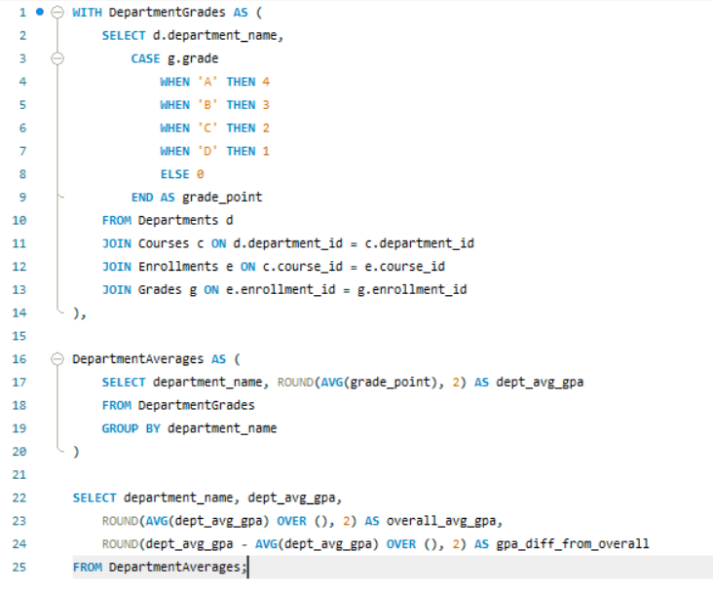
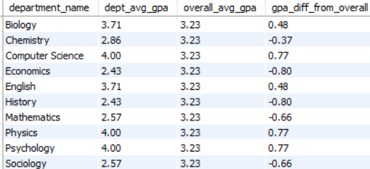
DQL: Reports and Analysis (Part 1 - University System)
Report 2: Average Grade per Department
Output:
Notes:
Our second DQL report calculates the average grade per department to assess academic performance. We used a CTE to compute grade points and averaged them by department, as shown. For example, Computer Science and Physics both have a 4.0 GPA, while Sociology averages 2.57. We also calculated the difference from the overall average GPA to highlight disparities, providing insights for curriculum adjustments or resource allocation.

Slide 11
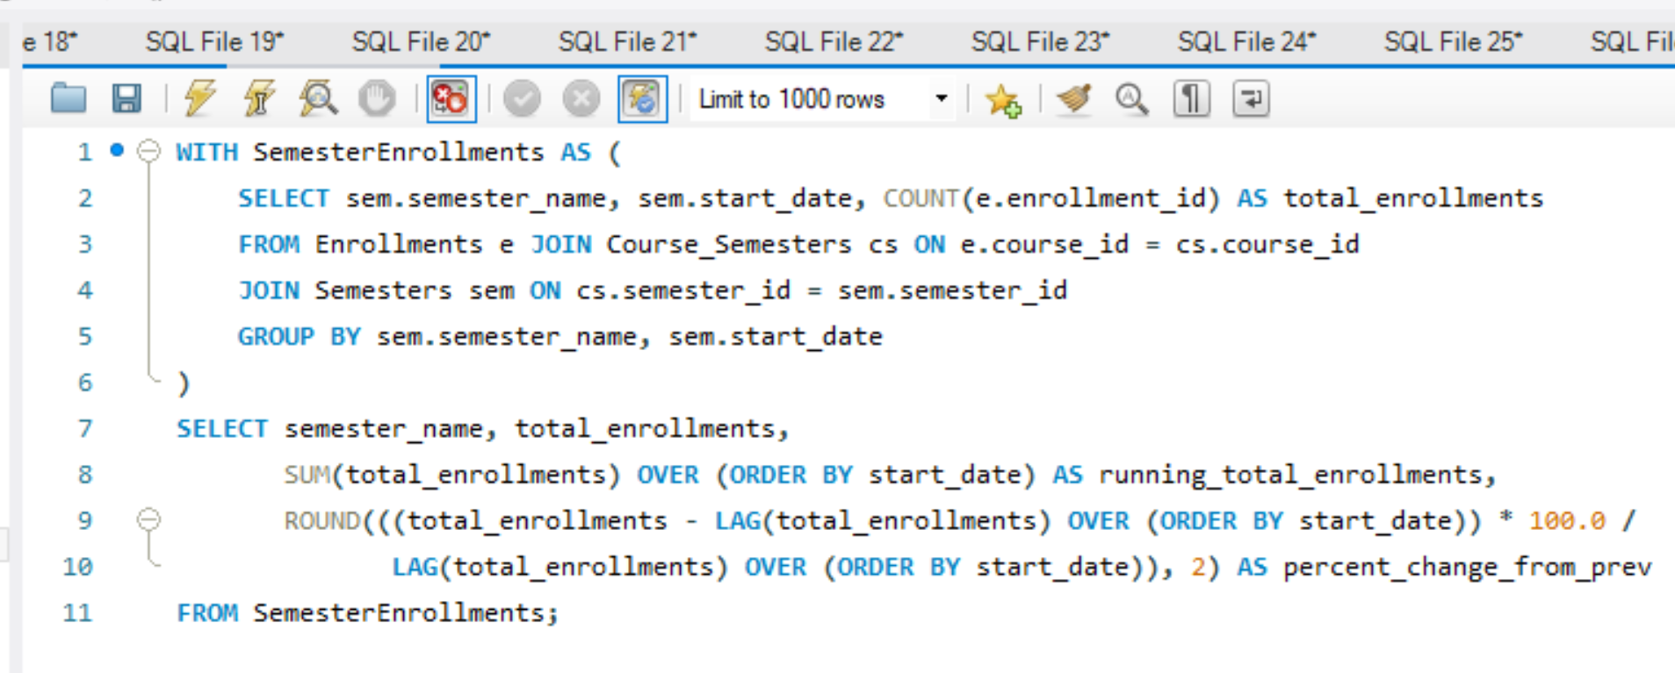
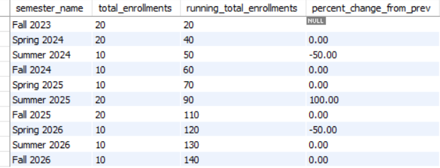
DQL: Reports and Analysis (Part 2 - University System)
Report 3: Enrollment Trends per Semester
Output:
Notes:
Our third DQL report analyzes enrollment trends per semester to understand student engagement over time. Using a CTE, we counted enrollments per semester and calculated the percentage change from the previous semester with the LAG() function, as shown. For example, Fall 2023 had 20 enrollments, but Spring 2024 dropped to 10—a 50% decrease. This time-series analysis helps the university plan course offerings more effectively.

Slide 12
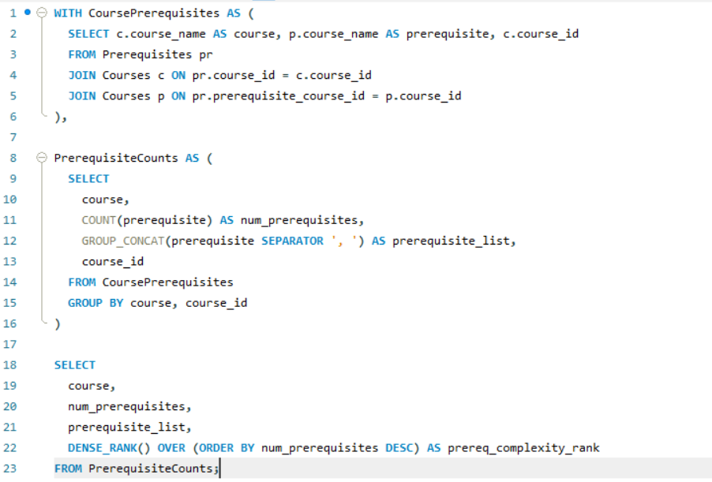
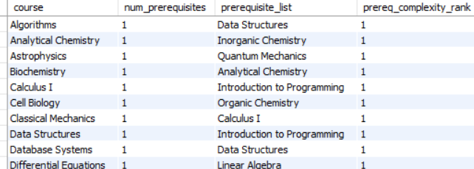
DQL: Reports and Analysis (Part 2 - University System)
Report 4: Courses and Their Prerequisites
Output:
Notes:
Our fourth DQL report examines courses and their prerequisites to understand curriculum dependencies. We used a CTE to list prerequisites for each course with GROUP_CONCAT and ranked courses by the number of prerequisites using DENSE_RANK(), as shown. For example, Astrophysics has Quantum Mechanics as a prerequisite, while Calculus I requires Intro to Programming. This analysis helps identify complex courses and optimize the curriculum structure.

Slide 13
Machine Learning Integration
University System Datasets:
Features for Predicting Grades: student_id, feature_student_avg_gpa, course_name, feature_course_credits, feature_department.
Features for At-Risk Students: student_id, feature_failed_courses, feature_avg_grade_semester, feature_num_enrollments.
Features for Course Scheduling: course_id, feature_enrollment_count, feature_avg_grade, feature_popularity_rank.
Features for Instructor Evaluation: instructor_id, feature_num_students_taught, feature_avg_grade_given, feature_avg_course_difficulty.
Example:
Predict student grades, identify at-risk students, optimize course scheduling, or evaluate instructor performance.
Notes:
Our database supports machine learning with datasets for predictive tasks, as shown here. For predicting grades, we use features like student average GPA and course credits;
for at-risk students, we track failed courses and semester grades; for course scheduling, we analyze enrollment counts and popularity ranks; and for instructor evaluation, we look at the number of students taught and average grades given. These datasets enable models to predict grades, identify at-risk students, optimize scheduling, or evaluate instructors.

Slide 14
Conclusion and Next Steps
Conclusion:
Functional university database with 10 tables.
Supports academic operations, machine learning, and additional business analyses.
Next Steps:
Add more tables (e.g., events, libraries).
Implement triggers for automatic updates (e.g., GPA).
Develop a dashboard for data visualization.
Notes:
In conclusion, we’ve built a functional university database with 10 tables that supports academic operations, machine learning applications like predicting grades, and additional business analyses, as outlined in our objectives. For next steps, more tables could be added for events or libraries, implement triggers for automatic updates like GPA calculations, and develop a dashboard for interactive data visualization to enhance the system’s utility. Thank you!

Slide 15
Thank you!

